Slide 1




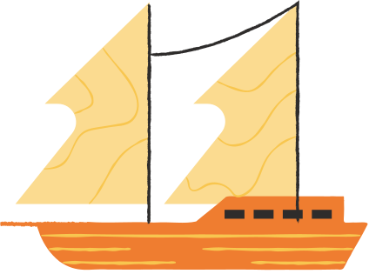
History of Vietnam
OOP Project - Object Organization

Slide 2
Content
Overview
Data Analysis
UML Diagrams
Design Analysis
OOP Techniques

Slide 3
Overview
Building a History Search Application that contains the information of Vietnam's dynasties, events, festivals, figures, relics. This project is created in order to collect data automatically and link those data to make an application which is able to search for information that is related to Vietnam. And the data source is taken from legitimate websites such as nguoikesu.com, Wikipedia, ...

Slide 4
Project Goals
First
Second
Build an application that is able to search for information which related to Vietnam (relics, events, dynasties, festivals, figures)
Able to show OOP techniques inside the application, how the system works, how entities link, ...

Slide 5
Data Analysis
Figure | ten, namSinh,namMat
Character | queQuan, danToc, namNhapNgu, ghiChu, namDoTrangNguyen
King | articleLink, mieuHieu, thuyHieu, nienHieu,tenHuy, theThu, namTriVi
Relic | name, location, type, rank, desc, characters, kings, dynasties
Festival | tenLeHoi, thoiGian, diaDiem, character, noiDung
Event | ten, thoiGian, diaDiem, nienDai, nhanVatLienQuan
Dynasty | startYear, endYear, name, kings, capital, founder
First, we are going to talk about the data types. In our application we have 7 entities which are Character, King, Relic, Festival, Event, Dynasty. And all of 6 entities will have the same 3 attributes from Figure: ten, namSinh, namMat

Slide 6





UML Diagram
Now, we are going to show you the diagrams that represent our application

Slide 7
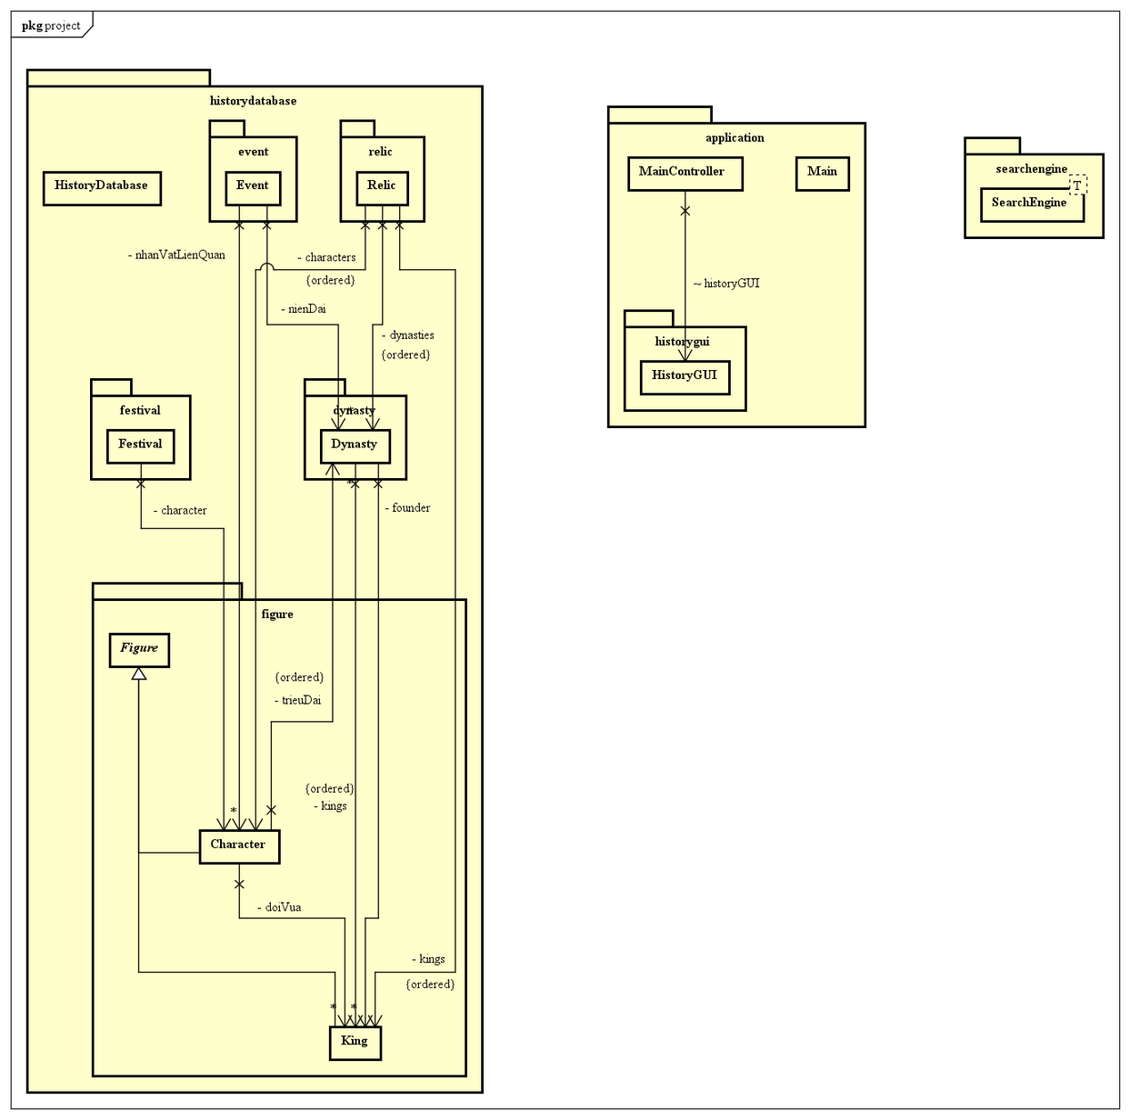
Package Dependcy Diagram
This diagram represent the dependencies of all the packages that appear inside the application. Crawlers will take most of the diagram

Slide 8
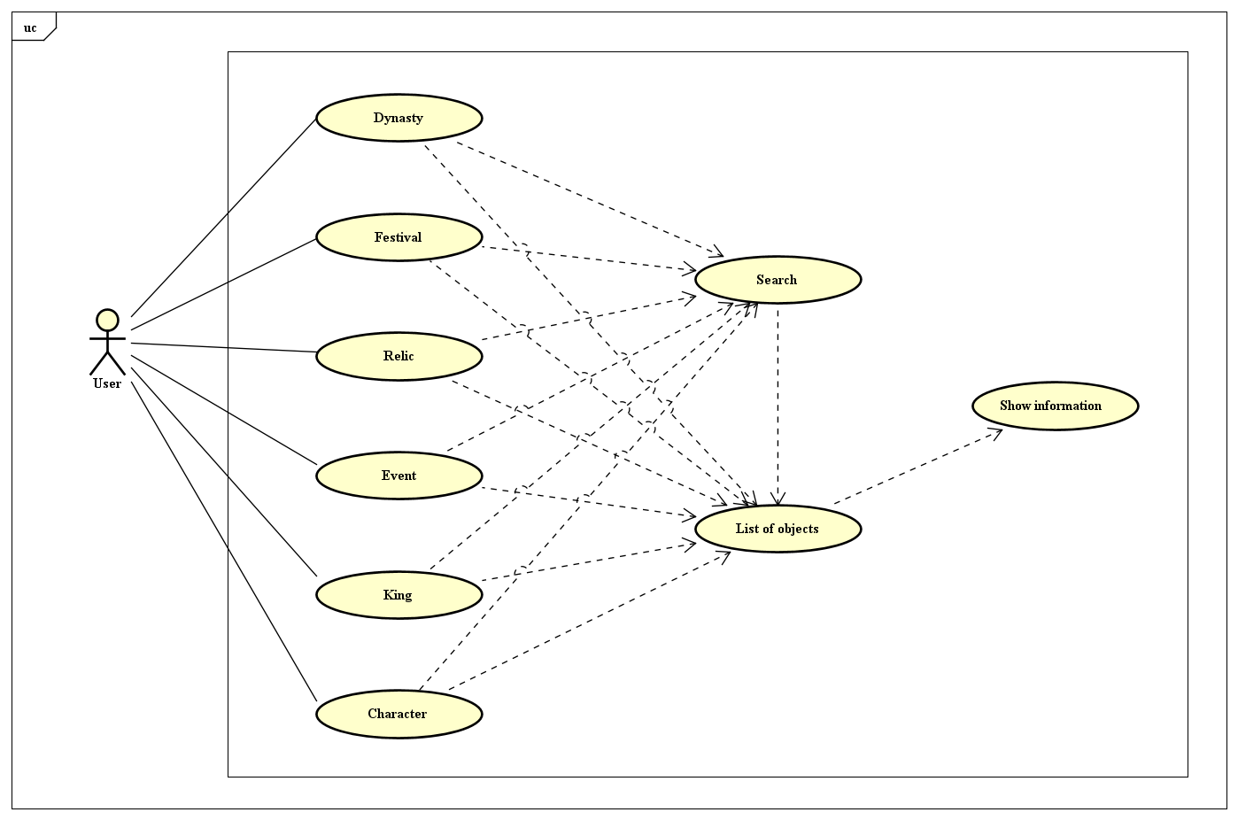
UseCase Diagram
This diagram represent how users interact with entities inside the application. Users can choose to search for an object or choose directly on list of objects

Slide 9
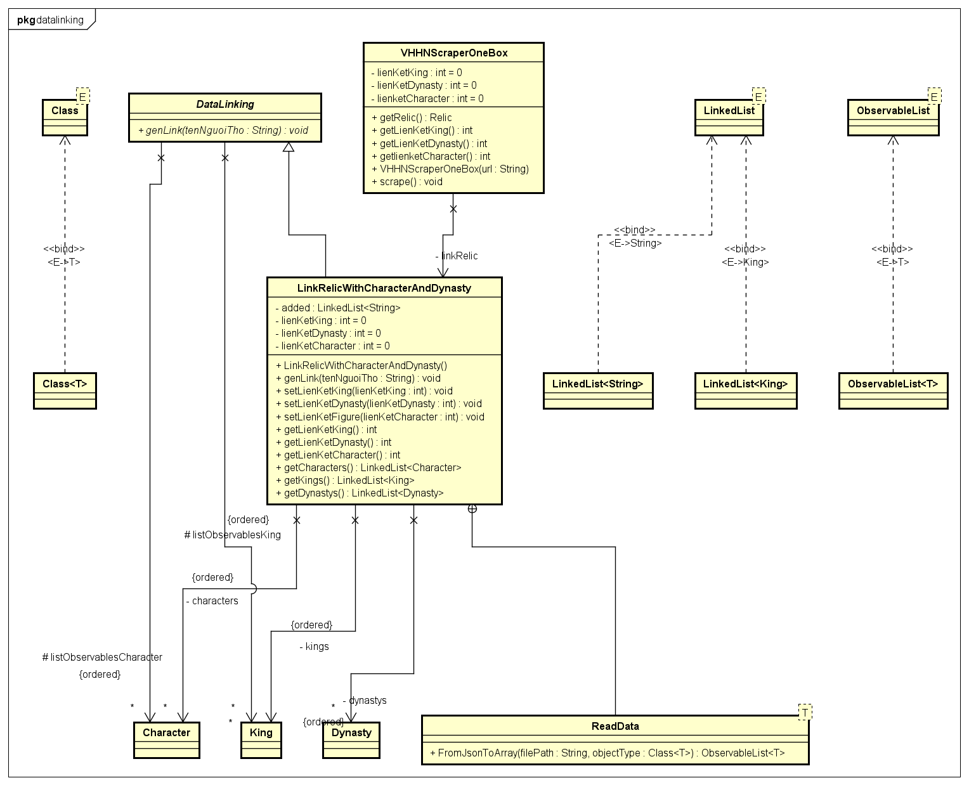
Design Analysis
Our design are represent in the following diagram

Slide 10
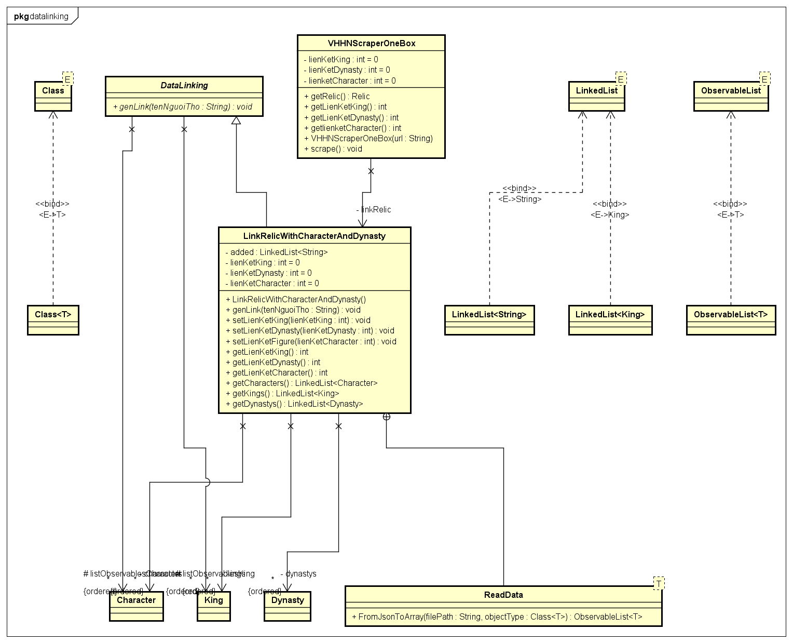
Crawler
We can only represent some of the scraper because we have many scrapers for
different urls

Slide 11


OOP Techniques
In this application, we are going to use 4 techniques
Abstraction
Polymorphism
Inheritance
Encapsulation

Slide 12
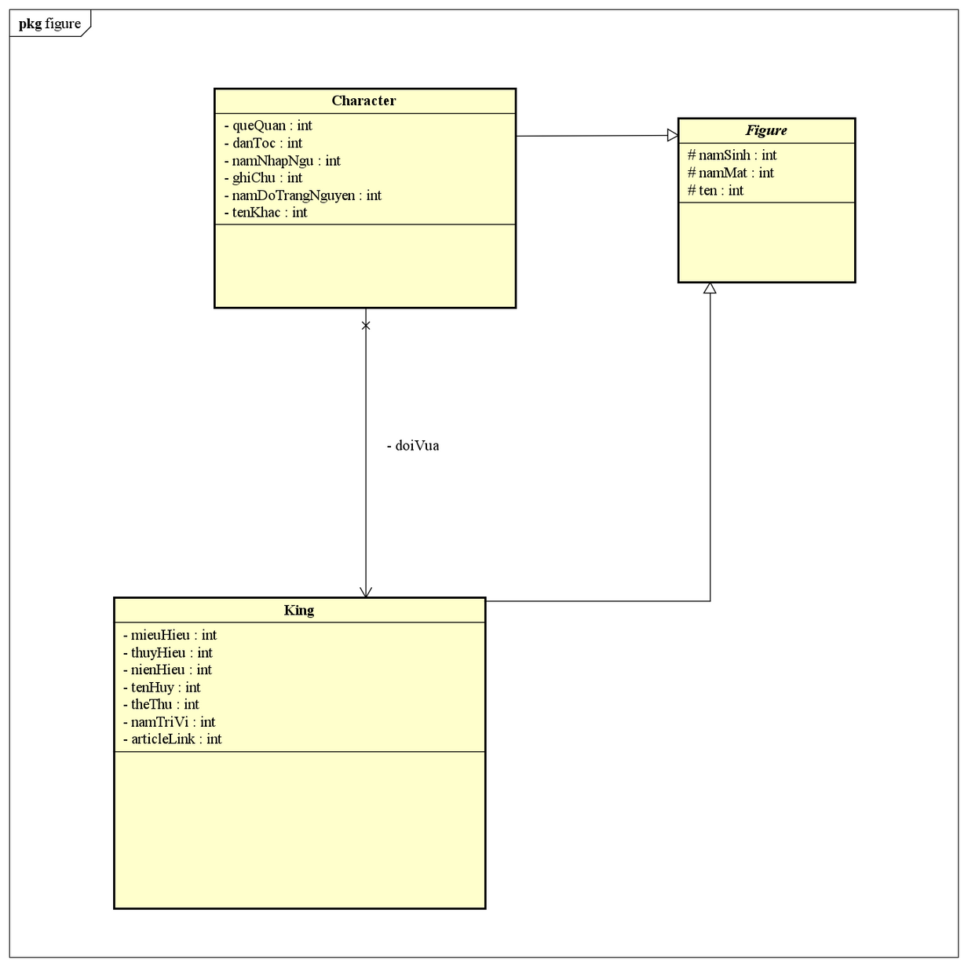
Abstraction
Abstract thinking using Interface and Abstract class in programming, specifically in the Crawler class for saving the crawled data to JSON and in the Figure class

Slide 13
Inheritance
Clearly demonstrated in the construction of classes for entities such as Character, King... because they all share common attributes such as name, namSinh, namMat
Inheritance is also demonstrated through the Crawler classes, such as CharacterCrawler, DynastyCrawler, FestivalCrawler... which inherit from the BaseWebCrawler class with attributes such as url and doc, since all Crawler classes need a url to connect and a Document to work with JSON files.
Smaller Crawler classes for each webpage also inherit from their respective parent class. For example, DynastyCrawler is the parent class with methods connect() and start(), and child classes such as NguoiKeSuDynastyCrawler and WikiDynastyCrawler will inherit these methods and execute them since they all need to connect and write to a JSON file."

Slide 14
Polymorphism
Mostly override crawler: Dynasty crawler, Event Scraping, King Scrape, ... And Functions to save json file

Slide 15
Encapsulation
Each class has private attributes that can only be accessed through getter() methods and modified through setter() methods. Encapsulating in this way avoids unauthorized access or makes it more convenient to modify the code. For example, if the Name attribute were public, when we wanted to modify it, we would have to search for all instances of this attribute and make changes, while with the setter() method, we only need to pass in the Name we want to modify.

Slide 16




Thank you!

